Slide 1
Random Forest
1 Definition
2 Solved equation
3 Geometrical Representation
4 Where to use?
5 Code Implementation

Slide 2
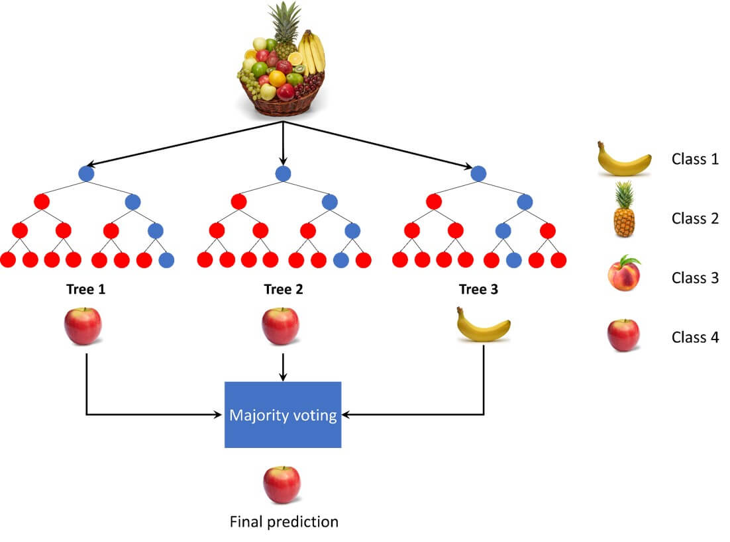
Random Forest Algorithm?
Random Forest is an ensemble learning algorithm that builds multiple decision trees during training and merges their outputs (majority vote for classification, average for regression). It’s robust to overfitting, handles large datasets, and works well with both categorical and numerical data.
How Random Forest Works
Bootstrapping (Sampling): Randomly select samples from the dataset (with replacement) to create multiple subsets.
Tree Building: For each subset, build a decision tree but only consider a random subset of features at each split (feature bagging).
Aggregation:
For classification: take the majority vote from all trees.
For regression: take the mean prediction from all trees.

Slide 3
DT: solved example
Training Data
Hours | Atted | Perct | results
2 | 70 | 30% | Fail
4 | 80 | 50% | Pass
1 | 60 | 40% | Fail
5 | 90 | 70% | pass
Hours
Atted
Att
Pct
Pct
Hr
Bootstrap Data
Hours | Atted | Perct | results
5 | 90 | 70 | Pass
5 | 90 | 70 | Pass
2 | 70 | 30 | Fail
5 | 90 | 70% | pass
Pct
Hr
Att
Test Data
Hours | Atted | Perct
10 | 95 | 85%

Slide 4
Geometrical Representation

Slide 5
Applications
✅ Credit scoring (fraud detection) ✅ Stock market prediction ✅ Image and text classification ✅ Feature importance ranking

Slide 6
Code Implementation
# Imports
from sklearn.ensemble import RandomForestClassifier
# Model
rf = RandomForestClassifier(n_estimators=100, random_state=42)
rf.fit(X_train, y_train) # Training
# Prediction
predictions = rf.predict(X_test)
print(predictions)

